Slide 1


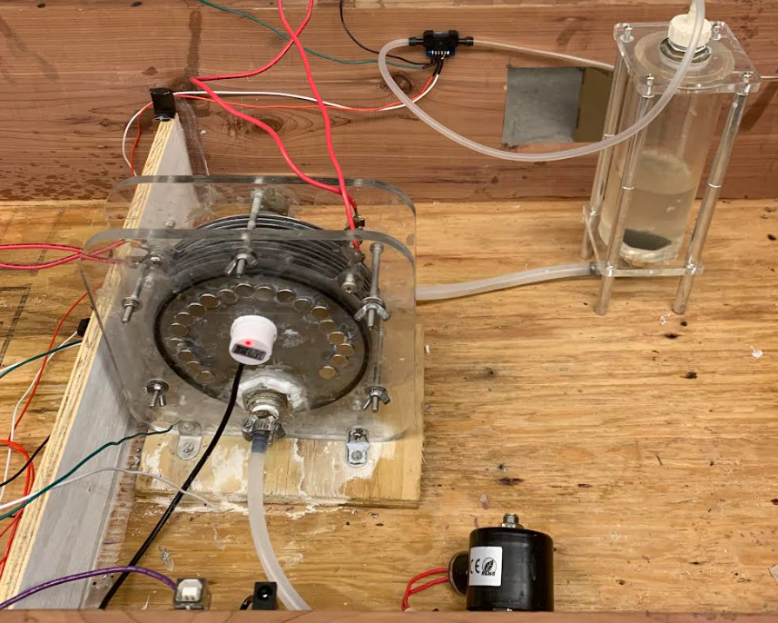

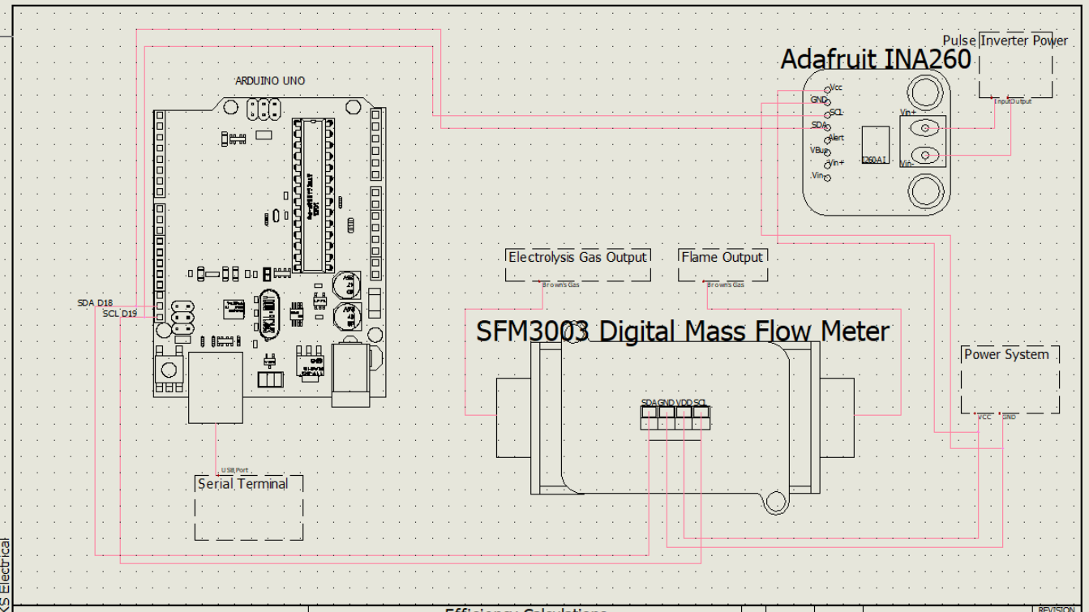
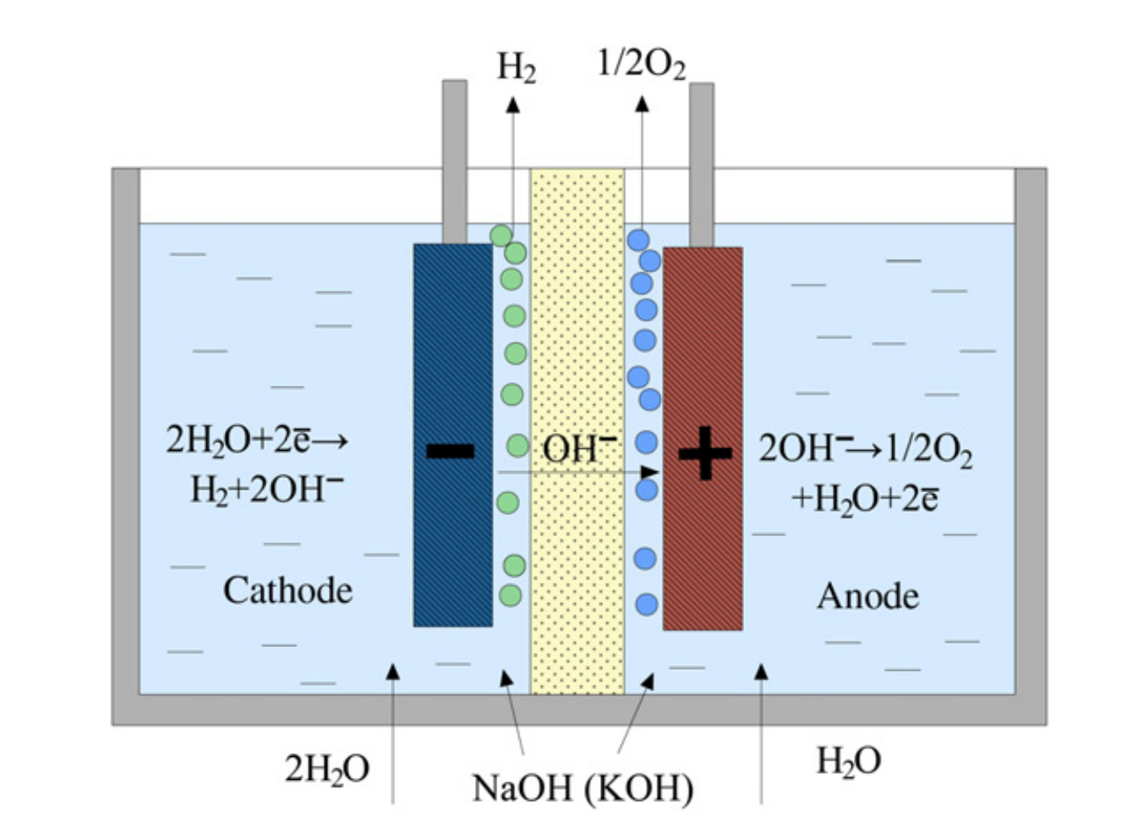
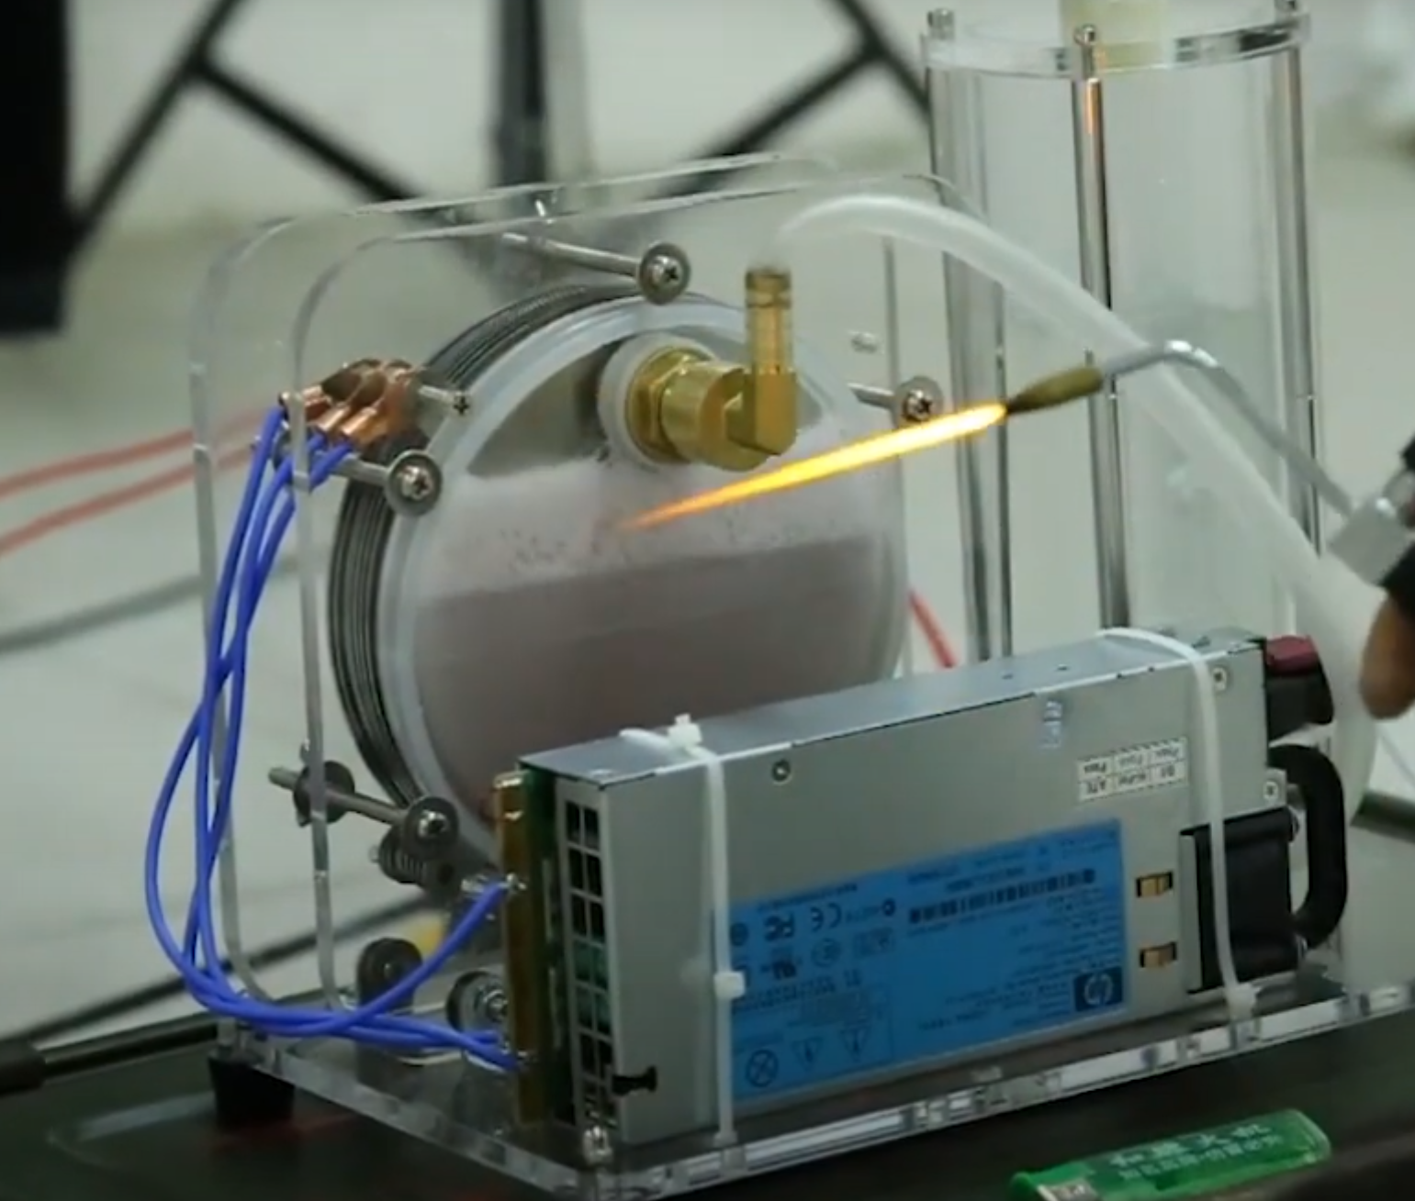
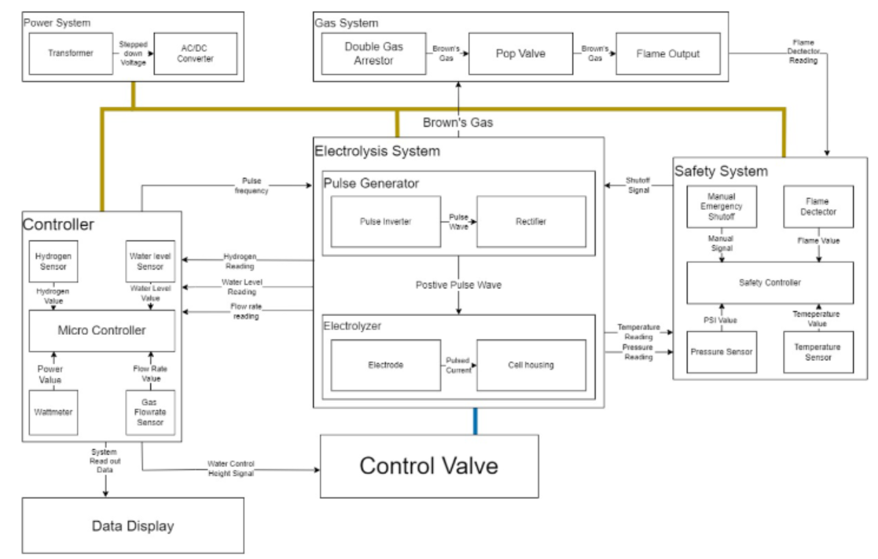
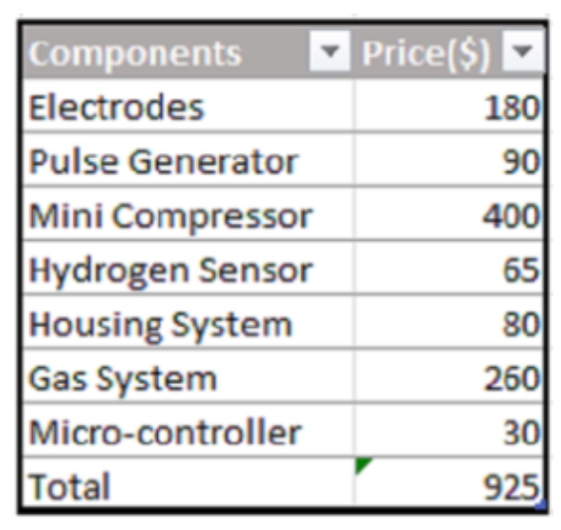
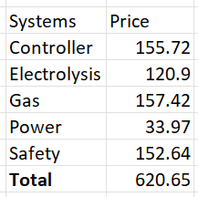

Pulse Inverted Electrolyzer
Brennan Angus, Matthew Beausoleil, Jacob Cooper, Wyatt Groves, Austin Jerrolds, Conner Sanders
Executive Summary
The goal of the project was to create an electrolysis system and make it as efficient as possible, while also taking standards of safety into consideration. The system should create a constant flame while it is run. The standards to be met required a variety of additions to the basic electrolysis cell, including a water level sensor and an emergency stop button. While the electrolytic cell was pre-made, the overall system needed to be designed around it, with functional and spatial limitations being considered.
Efficiency Boosting
Lye
Pulse Inverter
Magnets
Lye (sodium hydroxide) is used to help boost the chemical splitting of water into hydrogen and oxygen gas.
The pulse inverter is used to generate high-magnitude electrical pulses in order to try to boost the system’s efficiency. The pulses are rectified so that the polarity of the system is unchanging.
The magnets are placed onto the electrolysis cell in order to bias the ions’ location in the solution for faster oxyhydrogen generation.
What is Electrolysis?
Electrolysis is the process by which an electrical current is passed through a substance to trigger a chemical change. Water electrolysis occurs when a power source is connected to two electrodes which are immersed in water. When a voltage is created across the plates, water in the cell changes into hydrogen and oxygen gas. This results in the highly flammable mixture oxyhydrogen, commonly dubbed “Brown’s gas”.
Pictured (left to right): Austin Jerrolds, Brennan Angus, Jacob Cooper, Wyatt Groves, Conner Sanders, Matthew Beausoleil
Controller System Schematic
Architecture
Experimental Results
In experimentation, many constraints were tested and met. Functionality constraints included but were not limited to constant voltage supplies of 5V and 12V, the pulse generator’s output being rectified, and the prevention of water backflow out of the system. Safety constraints included but were not limited to the cell not being reactive with sodium hydroxide, the system having no dangerous exposed wires, and the inclusion of a functional emergency stop button. Constraints of accurate measurement, gas not being produced when there is no flame, and the inclusion of magnets were the only ones not met.
Predicted vs Real BOM
Predicted
Real
Future Improvements
Pulse inverter: The pulse inverter running at a higher frequency than what it is currently capable of could result in the cell being sufficiently powered.
Gas output sensor: The sensor used by the system was ruined by the oxyhydrogen being output. Using a different sensor would allow the output to be measured properly.
Magnets: The magnets used on the cell didn’t end up having notable effects. Using stronger magnets could help make the electrolysis process more efficient.
Electrolysis cell: While the cell that was used functioned overall, it had leaking issues that needed to be addressed and it proved to be inconvenient to take apart and work with.

